Slide 1
Creating Reports and Dashboards with Power BI
By Michael P. Antonovich
http://sharepointmike.wordpress.com
#Sharepointmikea

Slide 2
Please silence cell phones

Slide 3
My Published Books
User’s Guide to the Apple ][ - 1983
FoxPro 2 Programming Guide – 1992
Debugging and Maintaining FoxPro – 1992
Using Visual FoxPro 3.0 – 1995
Using Visual FoxPro 5.0 – 1996
Office and SharePoint User’s Guide – 2007
Office and SharePoint User’s Guide – 2010
Speaker at:
Code Camp Orlando
SharePoint Saturday Tampa & Orlando
SQL Saturday - #1, and over 30 others since then
IT PROCamp
PASS Summit 2012, 2013
Notes:
While this slide is up, ask everyone to introduce themselves to someone around them that they do not know.

Slide 4
Agenda
Show Reports pages using different built-in visualizations. Show switching from one visualization to another.
Show how to format visualization tables and charts.
Show how to add a Quick Calc Column in a table.
Show Condition Formatting.
Show Customizable Tooltips to display more data.
Create a Shape Map.
Show Table Styles.
Show Line Drilldown.
Show 3rd party visualizations web page: https://app.powerbi.com/visuals/
Show how to use a 3rd party visualization - Hierarchical Slicer
Show how to publish to PowerBI.com
Explain the different sharing models between PowerBI.com and Power BI desktop.
Show what PowerBI.com looks like - Open CONTOSO B http://www.powerbi.com
Show how to add (pin) a visualization to a desktop
Create a new desktop.
Talk about printing reports and desktops.
Show how to publish your results to a website.
Show website: http://districtcollaboration.ocps.net/team/webservices/antonovich (Not open to public)
Show PowerBI Mobile App on iPhone
Start learning now at: https://powerbi.microsoft.com/en-us/guided-learning/
Notes:
Open Contoso B
These are some of the topics I hope to cover. If I don’t cover them all, you can pull down the slide deck and review anything I don’t get to at a later date.
A couple of months ago I read a book titled, “Let’s Start with Why?” by Simon Sinek. The basic premise is that if you do not have a good why, you will not succeed in whatever you attempt to do. So, Let’s Start with Why?

Slide 5
Why Create Reports and Dashboards?
“To convey information from the analyst to the viewer so as to initiate an action on their part.”
Notes:
How do you do that?
With data listings (tables) and charts.
Data listings by themselves can be boring to interpret. However, the data listing may be displayed instead as a chart to show trends, variability,
Simple reports may also be made available to provide ADA compliance for charts and graphs.
In any case, we have to pay attention to how we create reports and what they look like and what point they get across compared to what point we wanted to get across.
Selecting the wrong chart type can be ineffective or even deceptive.
Recently, a greater emphasis has been placed on readability and clarity by everyone through the ADA

Slide 6
The Difference Between a Report and a Dashboard
A dashboard consolidates the most important information in a single screen without scroll bars to get a specific point across to the viewer. While it may be used along with detailed reports, the best dashboard stands alone
Dashboards are typically mean for high management to help make decisions
Reports are used by middle and low management to justify those decisions.
Notes:
Dashboards
Are for Upper Management
Used to make decisions without diving into the weeds.
Heavy on visualizations
Reports
Generally for consumption by middle to low management
Contain the information needed to backup any visuals in the Dashboards
Heavy on tables

Slide 7
Differences Between Version of Power BI
Power BI Desktop can create reports and publish to Power BI Pro, sometimes referred to as the free version of Power BI, but it cannot create dashboards or easily share reports with others. Think of the desktop version as the Developer’s version.
Power BI Pro can create reports and dashboards and allows you to share those reports with other Power BI Pro users within your organization. Power BI Premium includes Power BI Report Server and does not require individual user licenses to view reports within or outside of your organization.
Power BI Premium allows Power BI free users to view, but only Power BI Pro users can author new content and publish to Premium. Premium also allows you to download Power BI Server to create a local cloud.

Slide 8
Updates to Different Versions of Power BI
Power BI Desktop is free and can be downloaded from the Microsoft App Store. Updates occur monthly. Data (unless using live data connections) can only be updated manually.
Power BI Pro/Premium is sold as part of the Office365 SKU (Pro version has a 60-day free trial). Since it runs as an online services, updates can occur at any time. Data not from live data connections can be updated automatically once a day (or weekly) for Pro and hourly for Premium.

Slide 9
Updates to Different Versions of Power BI
 | Application Updates | Data Updates
Power BI Desktop | Monthly | No auto updates other than live data connections¹
Power BI Pro | At any time | Scheduled updates 1 time a day at 10,000 rows per hour
Power BI Premium | At any time | Schedule updates every 60 minutes at 1M rows per hour.
¹ Live Data Connections use current data at the time the report is displayed. User must be authenticated to the data source. Only a single data source can be live and cannot connect to other data sources. Current data sources that support live data include: SQL Server, Analysis Services, Oracle, Teradata and SAP HANA. Other restriction to live data may apply.

Slide 10
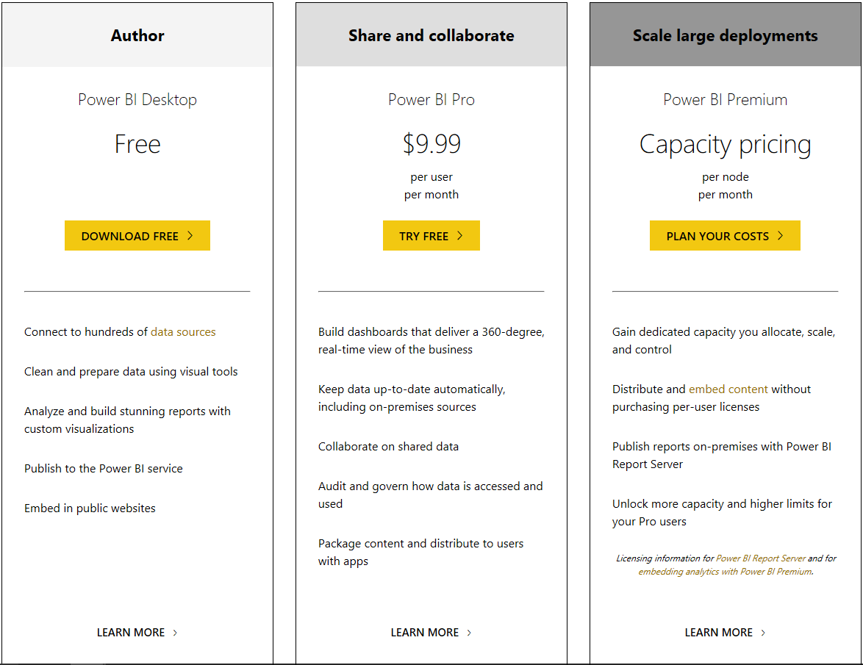
PowerBI Pricing
Tip:
Premium Pricing Calculator can be found at: https://powerbi.Microsoft.com/en-us/calculator
Source: https://powerbi.microsoft.com/en-us/pricing/

Slide 11
Power BI Report Server (included with Premium)
Power BI Report Server reports don’t support:
R visuals
ArcGIS maps
Breadcrumbs
Power BI Desktop preview features
Power BI Report Server reports don’t support these features in the Power BI mobile apps:
R visuals
ArcGIS maps
Custom visuals
Breadcrumbs
Geofiltering or bar codes

Slide 12
What is Accessibility
People with disabilities have access to and use of information and data comparable to the information provided to those who do not have a disability.
Standards include: WCAG 2.0 – Web Content Accessibility Guidelines
Section 508 of the Rehabilitation Act
EN 301 548 – A European Standard

Slide 13
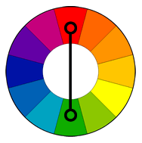
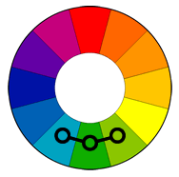
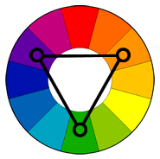
Selecting Colors – Part 1 Basic Hue Selection
Base color selection on the standard color wheel of 12 hues.
Complimentary Colors
Colors that are opposite of each other on the color wheel
Analogous Colors
Colors that are next to each other on the color wheel
Triadic Colors
Colors that are evenly spaced around the color wheel
One method not shown here is to just select a single color and choose different tints, shades and tones. This is called Monochromatic colors.
Notes:
Basic color selection can best be examined by using a color wheel.

Slide 14
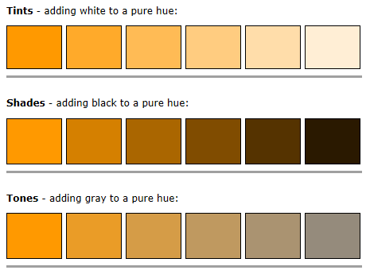
Selecting Colors – Part 2 Tints, Shades, Tones
Notes:
Defining Tints, Shades, and Tones.
Another important aspect of selecting colors is color contrast between foreground and background colors, particularly text.

Slide 15
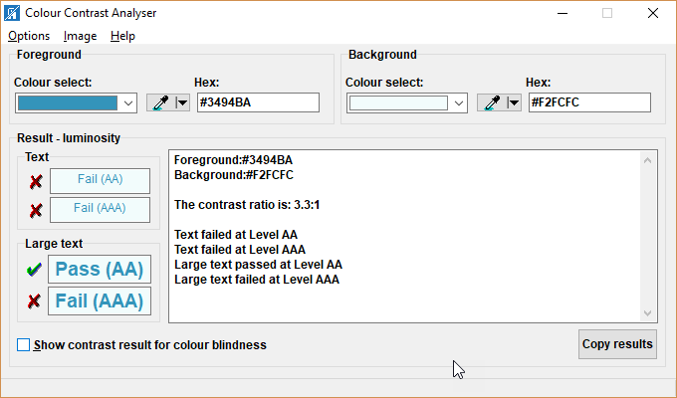
Accessibility Colour Contrast Analyzer
Does your report have a contrast ratio of at least 4.5:1 exist between text, and images of text, and background behind the text?
AA = Contrast ratio of at least 4.5:1 between background and foreground. 3:1 for large text (over 18 point or 14 point bold)
AAA = Contrast ratio of at least 7:1 between background and foreground. 4.5:1 for large text (over 18 point or 14 point bold)
https://developer.paciellogroup.com/resources/contrastanalyser/
Notes:
The American Disabilities Association has defined a set of rules to insure that all people with different vision challenges can clearly read text.
The most obvious rule is color contrast.
There are three major type of color blindness and this tool has options to help you select colors that work with them all.

Slide 16
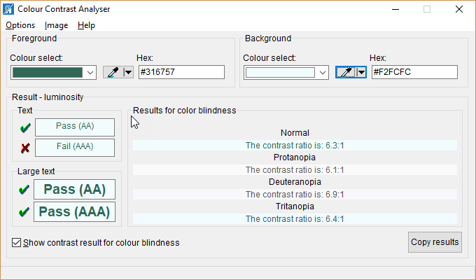
Accessibility Colour Contrast Analyzer
Types of Color Bindness
Protanopeia – Red-Green color blindness relates more to their sensitivity to red or green light.
Deuteranopia – Red-Green color blindness is the most common form and is found in 6% of males.
Tritanopia – Blue-Yellow color blindness confuse blue with green an yellow with violet.
https://developer.paciellogroup.com/resources/contrastanalyser/

Slide 17
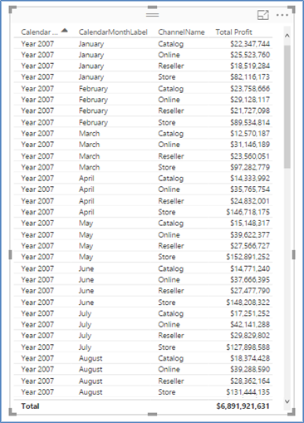
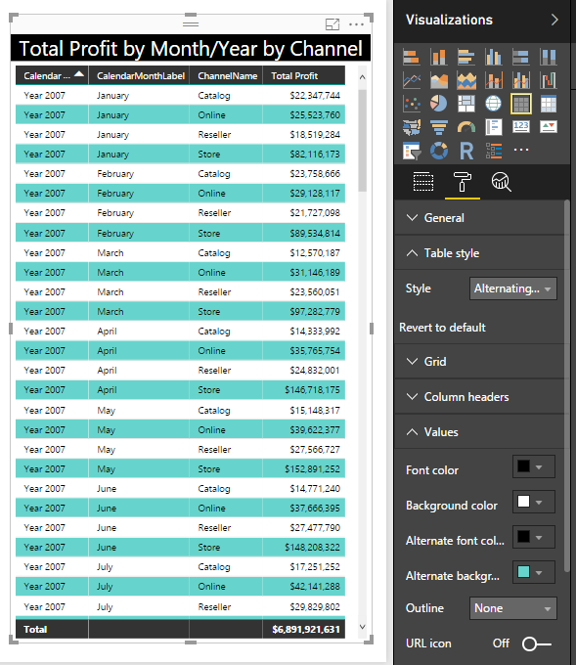
Table Visualizations have Formatting Options
Each release of Power BI adds more formatting options and visualizations.
Table styles provide a basic framework within which you can customize the colors, fonts, and line sizes further.
The table on the left was formatted with just a few options to appear as the table on the right. Some of the format options are also visible.
Notes:
Let’s start with something simple, a basic table.
Slide 5
Go To Tab: Page 1
Formatting – Table Style: BoldHeader Flashy Rows
Formatting – Values – Change background → color to show customization
Formatting – Title Total Profit by Month/Year/Channel
Background Color Black
Foreground Color White
FontSize 14
One way to select colors is to use the Theme Gallery: https://community.powerbi.com/t5/Themes-Gallery/bd-p/ThemesGallery, but we will get to that later, first, let’s take a quick look at some color basics.

Slide 18
Consider the Effect of Printing
Don’t use dark colored backgrounds. Often people use dark colors for backgrounds of text or even for the entire visualization. While you may think this looks good on the screen, it often does not print well. In any case, you still must consider the rules of color contrast between the foreground and background.
Also consider that printed colors do not always appear the same as colors on the screen.
When text crosses other chart elements, the color contrast ratio must be considered for each color combination.

Slide 19
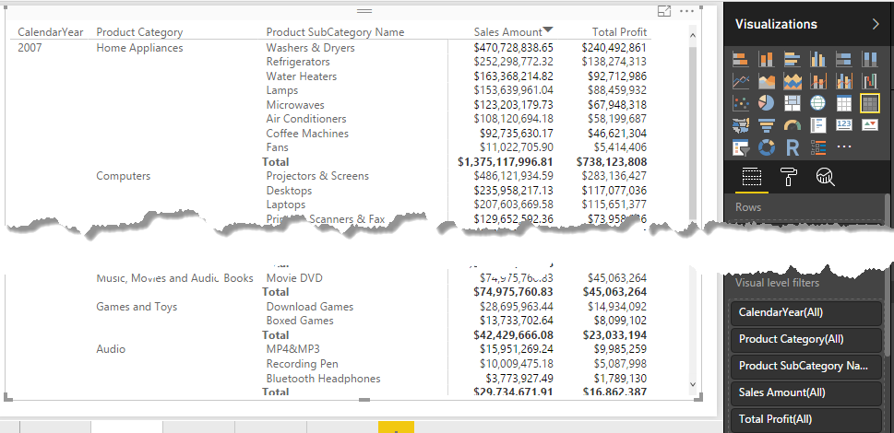
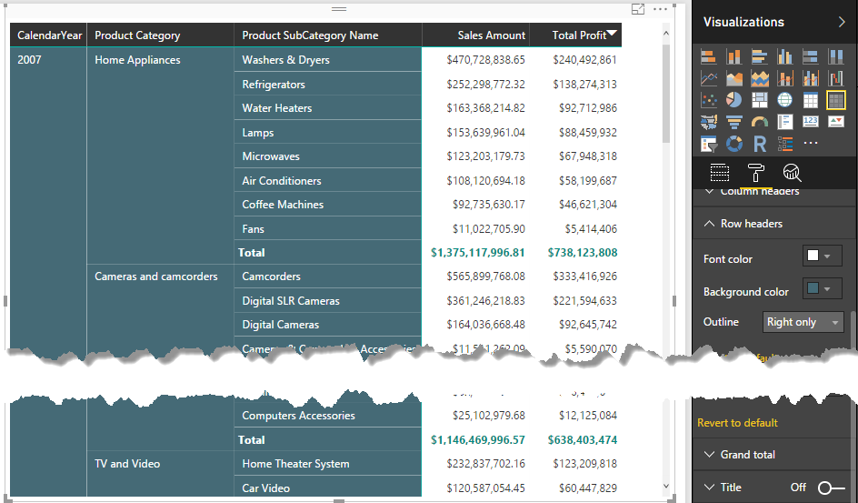
Using predefined styles, then further customize.
Format Matrix Tables
Part of creating a good report is formatting the data, tables and charts to make them attractive to the eye.
Try to stay in the same color family and font family at least within the same report page if not the entire set of.
Notes:
Slides 6-10
Go To Tab: Page 2
Matrix Style Bold Header
Row Header Background Color Dark Aqua
Subtotals Font color Dark Aqua
When you have a large amount of data, you often need a way to select just the data you want to see. In Power BI that calls for the use of a Slicer (filter). However, for matrix tables, a single slicer is usually not enough. You need to select fields from the hierarchy and thus the Hierarchy Slicer was developed. Where can you find it? In with other visualizations in the Power BI store.

Slide 20
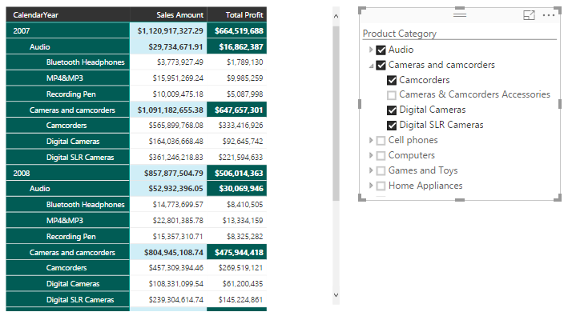
Space Saving Matrix Style for Tables
There is a new matrix visualization. It’s main advantage is the way it displays the hierarchy of row headers. Rather than use a separate column for each level, it uses an indentation. This will save you horizontal space and you can control the indentation through the properties. You can even revert to the old style.
Note: Totals are always in the header of each section.
Notes:
List of existing data may not always be enough.
Introduce the advantage of a hierarchy slicer which is not a standard visualization, but a custom one.

Slide 21
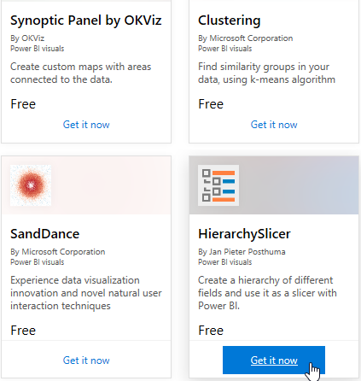
Custom Visualizations from 3rd Parties
You can download Power BI Visualizations at: https://app.powerbi.com/visuals/
Each month, you will usually find new ones.
In this case, I want to use the Hierarchy Slicer.
You only have to download and install the visualization once on your machine and then you can use it in multiple reports.

Slide 22
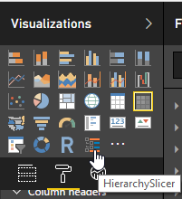
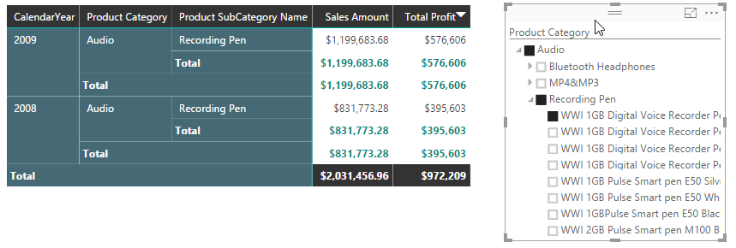
Adding and Using 3rd Party Visualizations To Power BI
You add a downloaded visualization by clicking on the ellipsis button in the bottom row of the Visualizations section
After it is added, it appears as an icon and can be added to any report by adding one or more fields to an empty area and then clicking the icon for the visualization.
Notes:
Note: It adds the 3rd party visualization to the current project. It does not become a permanent addition to the Power BI visualizations. So if you want to use it in a different project, you have to re-upload it inot that project. However, it does get saved with the project so you do not have to re-upload it each time you open the project.

Slide 23
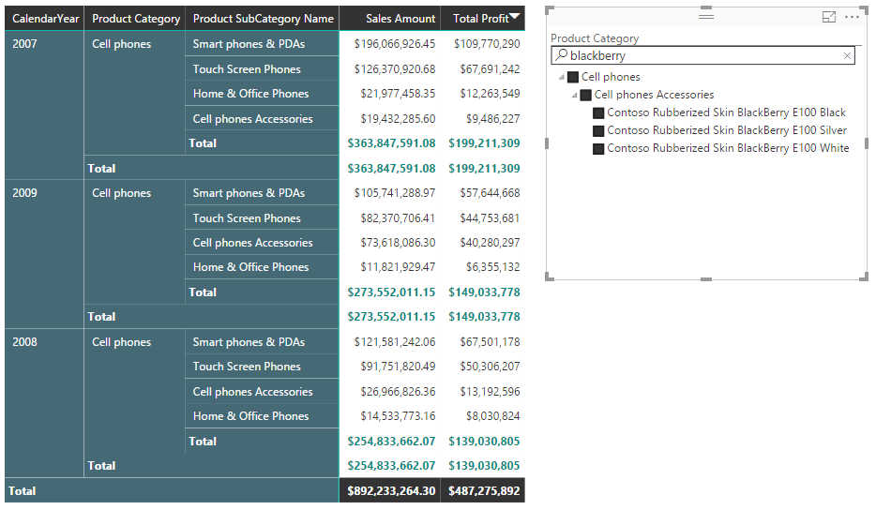
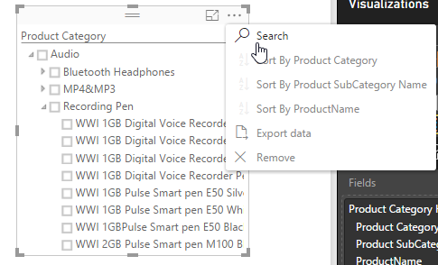
Use Search in the Hierarchy Slicer
Use Search to find a specific product such as all the Blackberry phones.
Notes:
Demo the use of the hierarchy Slicer and the search for blackberry.

Slide 24
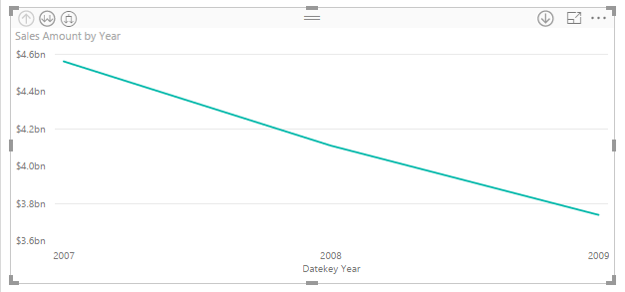
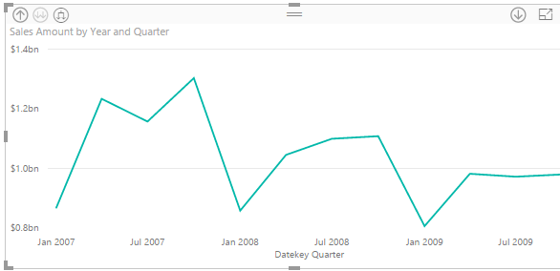
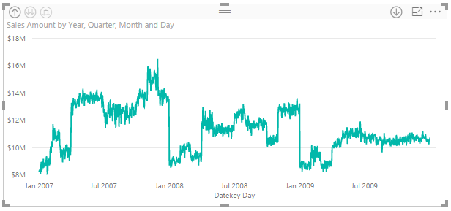

Drill Down Using a Timeline Chart
Drilldown works with a timeline chart or one with a hierarchy as the x-axis and allows you to move between different levels of aggregation with a simple click of the button.
Notes:
Drill down lets you view variability or to hide minor fluctuations to see the big picture.

Slide 25
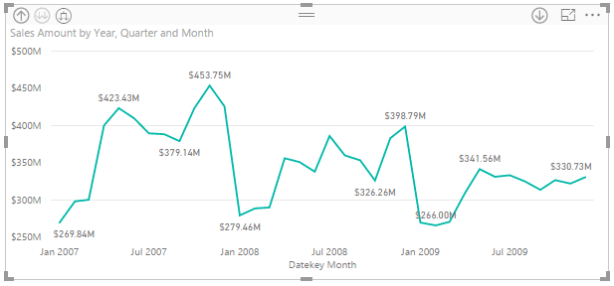
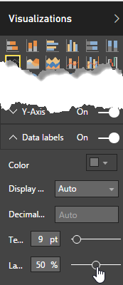
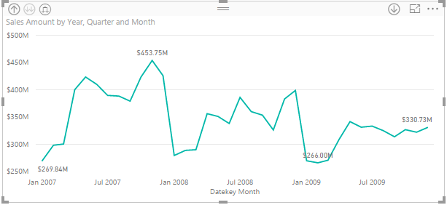
Label Density
Can you have too many labels on a chart?
Yes!
The Line visualization has an option called Label density which allows you to change how many labels are displayed. Just look at the two versions of the same chart on this page. One has 10 data point labels and the other only has 4 data point labels.
Note: Axis must have continuous values (numbers or dates), not categories.
Notes:
But accessibility is more than just line density and analytics. Users need to be able to tell one line from another.

Slide 26
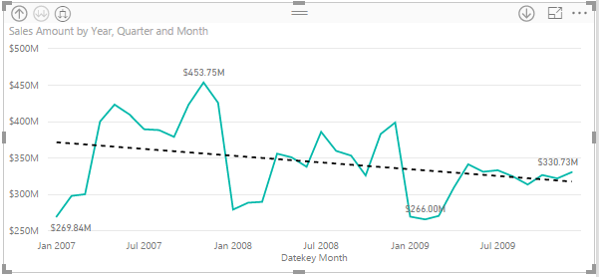
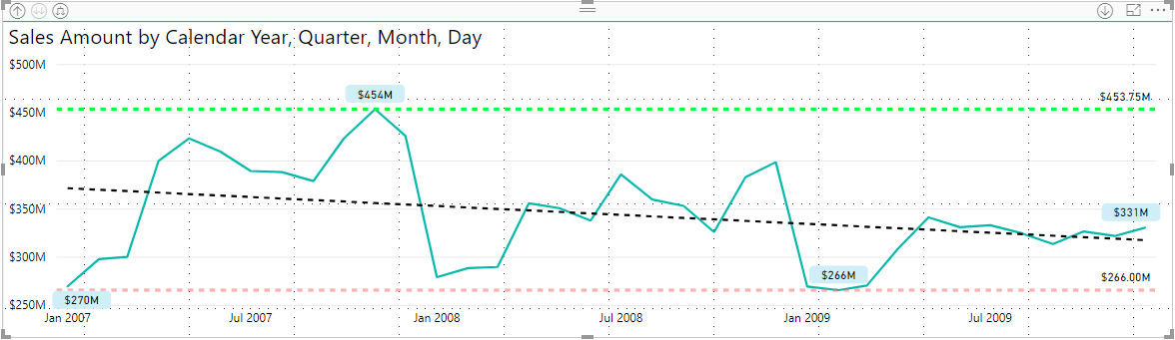
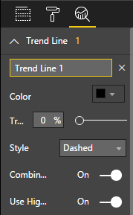
Use Data Analytics to Show Trends
The Types of data analytics included are:
Trend Line
Constant Line
Minimum
Maximum
Average
Median
Percentile Line
Forecast
Notes:
Slides 12-13 – Trends
Go To Tab: Page 3
Add a line chart of Sales Amount by Datakey
Show Analytics for: Trend line; Min Line; Max Line
Go into Format --> Data Labels and change the density of the labels
Show drill down capability
Show trend, min, max and forecast.

Slide 27
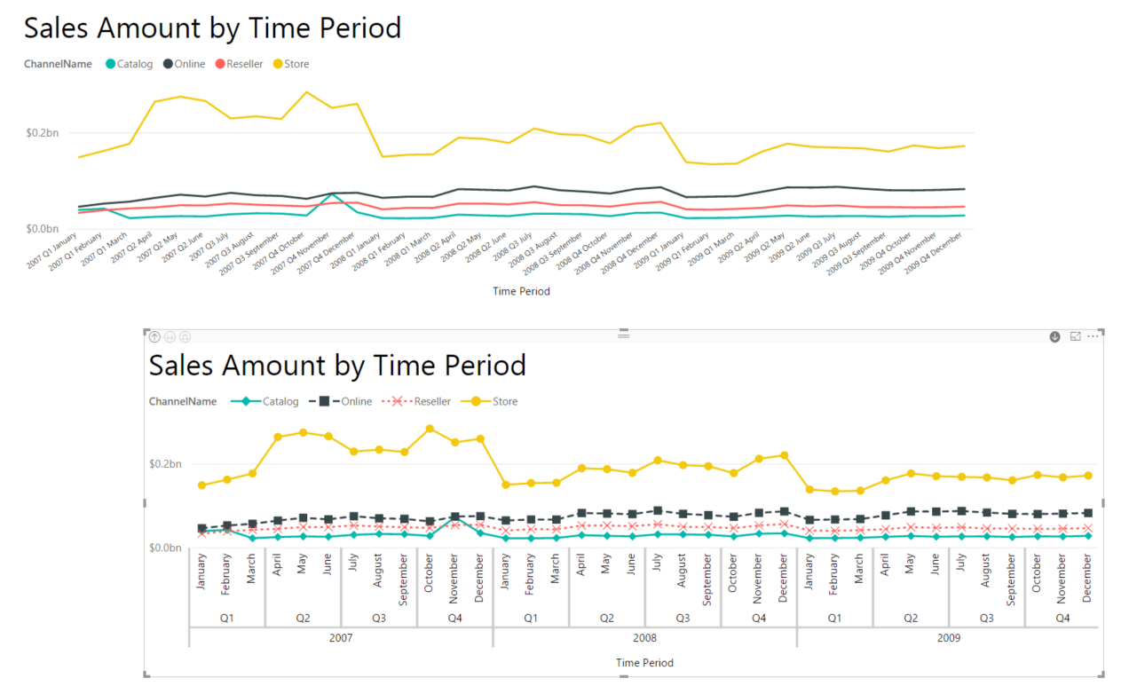
Accessibility – Use Line Styles and Markers
Notes:
Go To Tab: Page 6
There are 24 different combinations of line types and markers to help make matching of lines to legend keys easier.
3 line types
8 Marker types

Slide 28
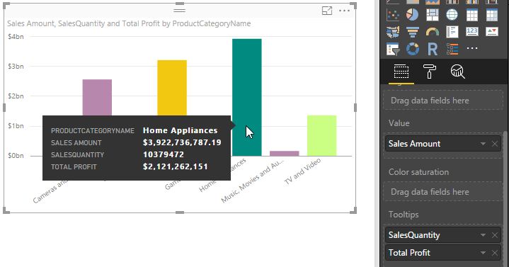
Add Measures to ToolTips
Tooltips originally displayed the data used to generate the chart.
Now you include any other numeric value and Power BI automatically calculates the sum of that factor. But you have other aggregate options as well
Notes:
Slides 16
Go To Tab: Page 3 – Upper Right
To bar chart, add tooltips: Sales Quantity and Total Profit.
Show how to change the sort order.

Slide 29
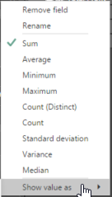
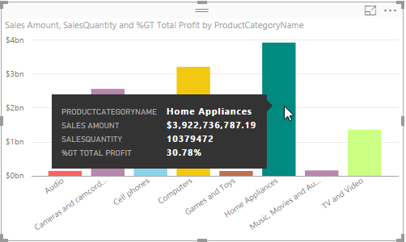

‘Quick Calc’ – Show Value As
One interesting quick calc you can perform for a tooltip property is a calculated measure of the Percent of Grand Total of the base field.
Notes:
Slide 15
Page 3
Change to % of total in Quick Calc for tooltip
Quick Calc expressions are common calculations on data that could also be performed using DAX but would require more effort. They can be modified after using them. Think of them as a short cut to many common calculations.

Slide 30
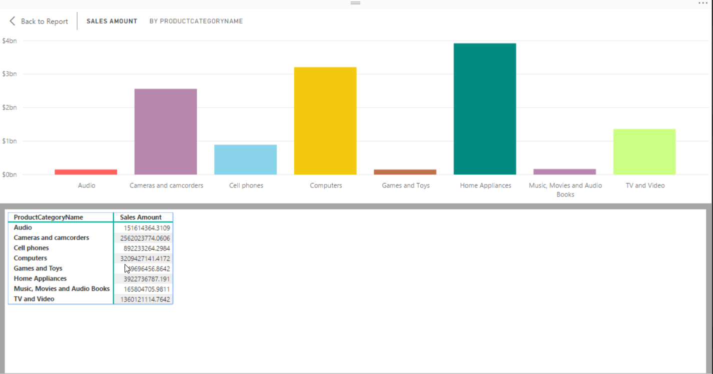
Accessibility – See Data from a Chart
To see the data that makes up a chart, simply select the chart first and then click ALT+SHIFT + F11
Notes:
When a chart is displayed, a person with visual challenges may not be able to interpret what it is displayed. ADA requires that charts also include tables of the data used to build the chart.

Slide 31
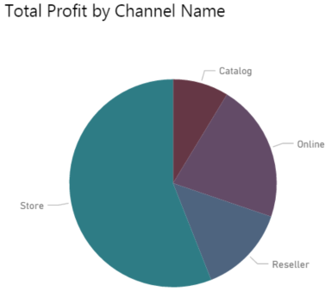
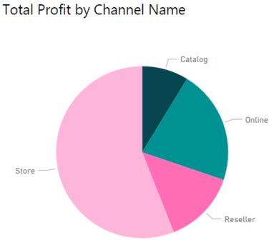
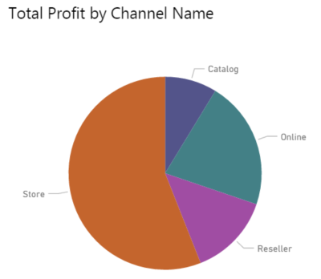
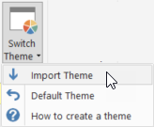
Accessibility – Not all Themes are Good
Plum
Color Blind
Urban
Download Themes:
https://community.powerbi.com/t5/Themes-Gallery/bd-p/ThemesGallery
Tools to help create color themes:
https://color.adobe.com/create/color-wheel/
https://powerbi.tips/tools/report-theme-generator-v3/
https://powerbi.tips/tools/advanced-color-theme-generator/
Notes:
Just because a theme exists, does not mean that it is ADA compliant for all visually challenged people. There are 3 major types of color blindness, each with their own unique combinations of colors.

Slide 32
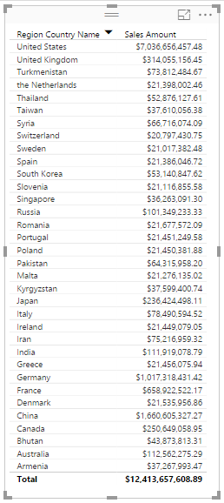
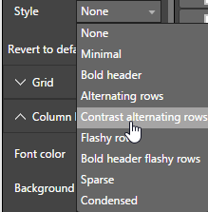
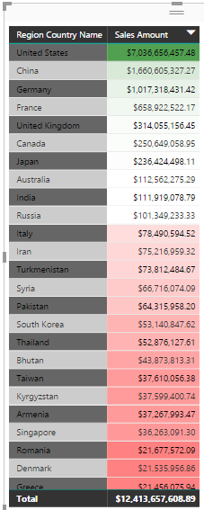
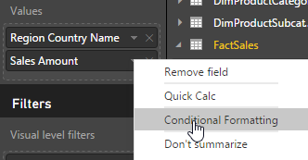
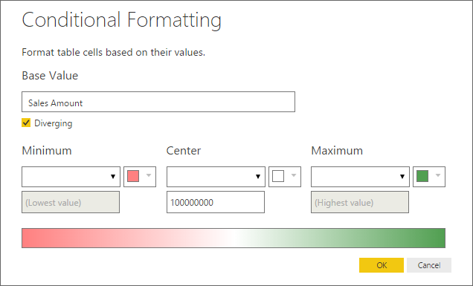
Combining Styles with Conditional Formatting
Notes:
Slide 16
Go To Tab: Page 4
Change table style to: Contrast alternating Rows
Sales Amount under Values & apply conditional
Add a diverging value to be a midpoint of 100,000,000 otherwise by default the midpt is 3,500,000,000
Page 4 – Column Chart
Data Labels – Where are they displayed and what is their orientation
Under formatting Data Colors
Show how to highlight a single column to emphasize a particular category
Under Fields → Color Saturation – Put Sales Quantity to show variation by another measure in which shading reflects relative size of that measure
Change Column chart to display total sales, costs, and profits
Overall chart selection guides:
Use line, area, ribbon, waterfall charts for data that varies with time
Use bar, column, pie, charts for data that varies with categories.

Slide 33
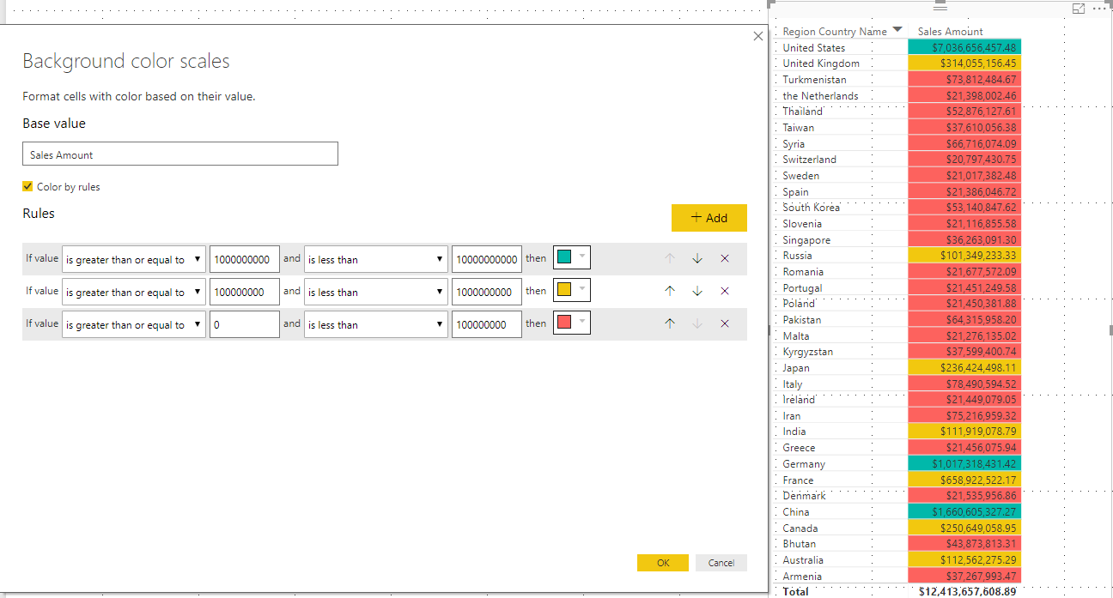
Rule Based Conditional Formatting
Notes:
Slide 16
Go To Tab: Page 4
Change table style to: Contrast alternating Rows
Sales Amount under Values & apply conditional
Add a diverging value to be a midpoint of 100,000,000 otherwise by default the midpt is 3,500,000,000
Page 4 – Column Chart
Data Labels – Where are they displayed and what is their orientation
Under formatting Data Colors
Show how to highlight a single column to emphasize a particular category
Under Fields → Color Saturation – Put Sales Quantity to show variation by another measure in which shading reflects relative size of that measure
Change Column chart to display total sales, costs, and profits
Overall chart selection guides:
Use line, area, ribbon, waterfall charts for data that varies with time
Use bar, column, pie, charts for data that varies with categories.

Slide 34
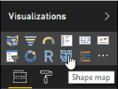
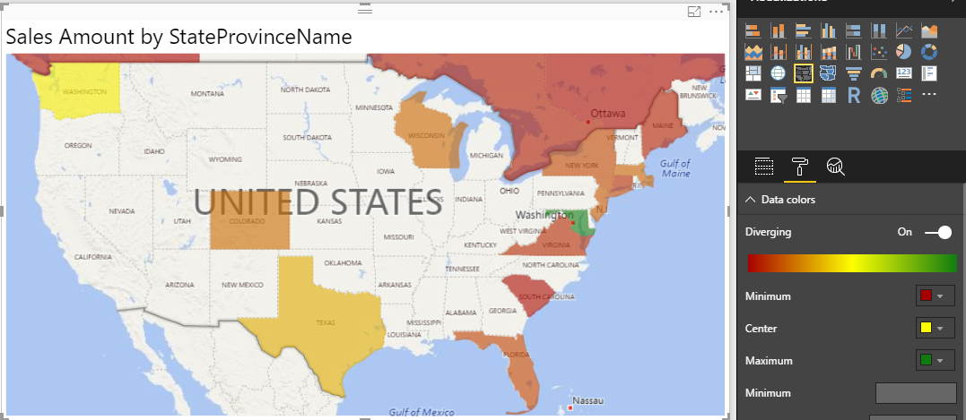
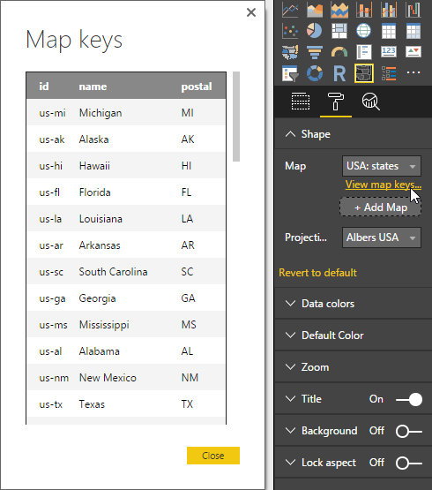
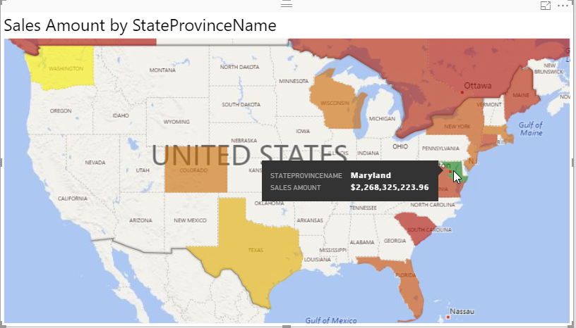
Using Filled Maps to Show Geographic Data
Notes:
Slide 17
Create new page using Sales Amount for color saturation and Geograph.state for the location
Make State borders more pronounced
Change Data Color perhaps red to green.
Area and Circle representation of map data.
Filled Map can only represent one measure via color
Map (with circles) represents two measures via the size of the circle and its color.

Slide 35

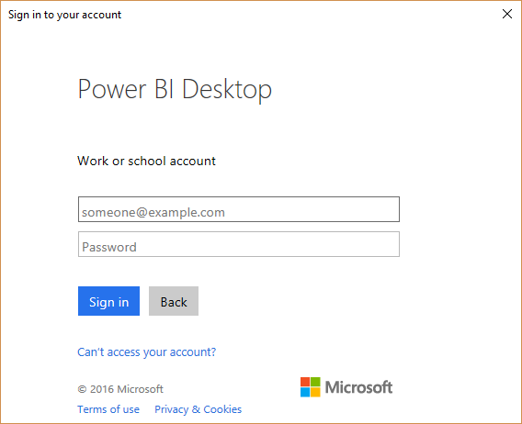
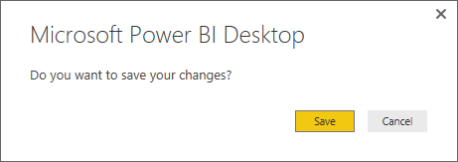
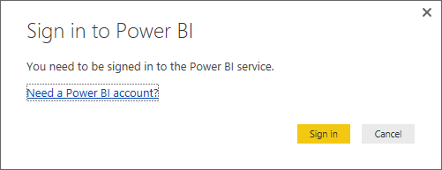
Publishing/Sharing Your Data
Select the Publish button from the ribbon.
Then follow the screens to log into your Power BI account.
Publishing can take several minutes depending on the size of your file
Notes:
http://www.powerbi.com

Slide 36
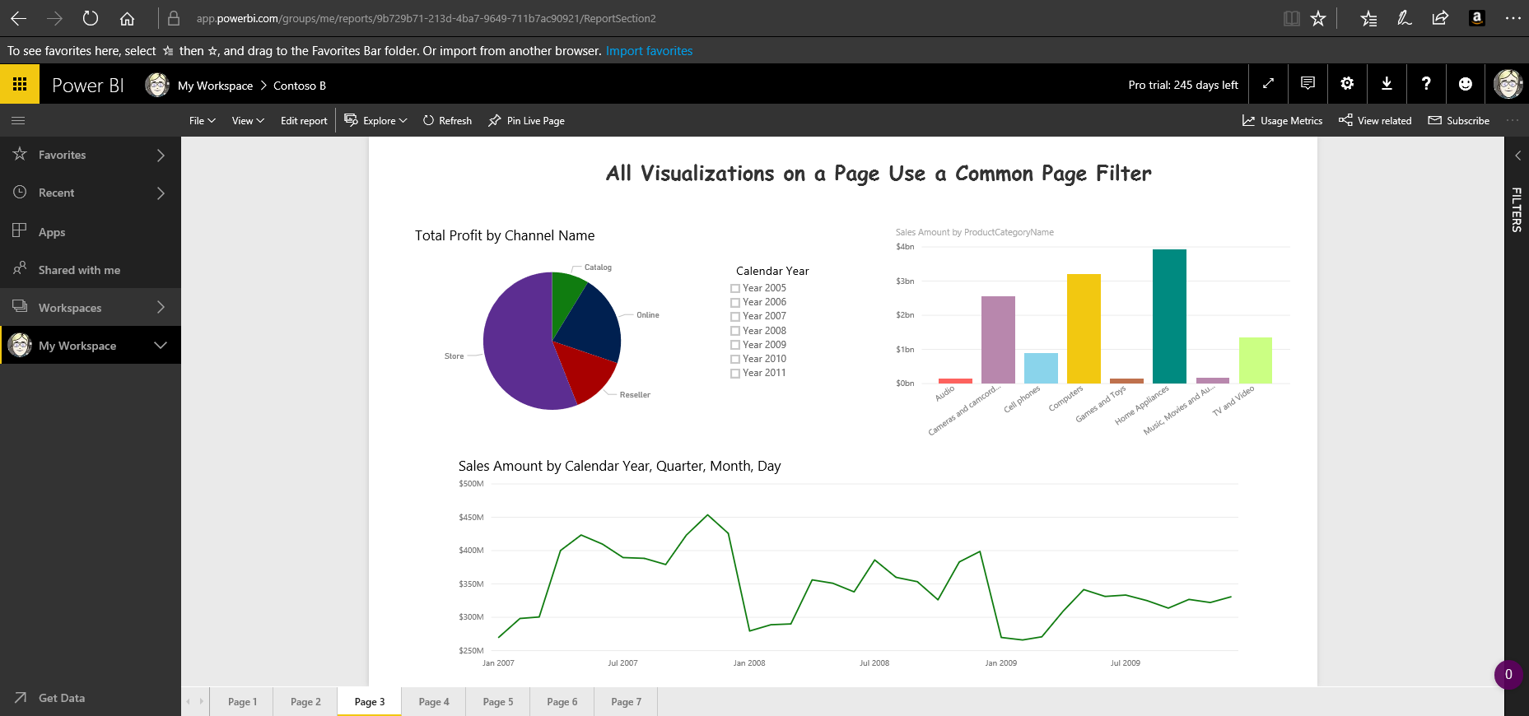
Example of Published Power BI Reports
Login into your account at: http://www.powerbi.com

Slide 37

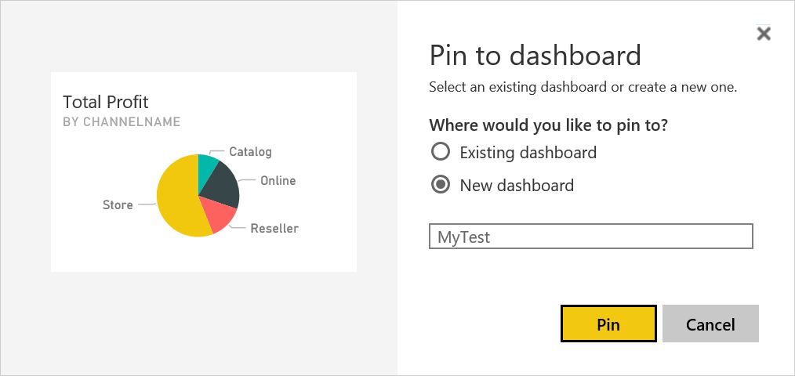

Pinning Report Elements to a Dashboard
Pin an entire report
You can pin a report or an individual data visualization to an existing dashboard by selecting the dashboard by name or you can create a new dashboard by entering a new dashboard name.
Pin individual visualizations
Notes:
Slide 18-
Login into http://www.powerbi.com
Username: 47758@ocps.k12.fl.us
Password:
Both Reports and Dashboards can be printed.

Slide 38


Viewing Dashboards
After pinning your visualizations to dashboards, you can open any one you want by clicking on its name.
An asterisk indicates a new dashboard

Slide 39



Querying the Data in your Dashboard
From the dashboard, you can ask questions about the data in the dashboard using English. Power Bi determines the best way to display your answer, numeric, table, or chart.

Slide 40


Get the Code to Publish Your Report to the Web
When you select: Publish to Web, a dialog provides a link you can use on a web page, not just in email, and the <iframe> code to embed the report in any web page.
Notes:
You can publish reports to the web or to SharePoint by either:
Using a link to go to the report
Embed the information inside a page to display the report automatically

Slide 41



How Your Report Might Look on a Web Page
Add a simple hyperlink:
Or embed the code for the report
http://districtcollaboration.ocps.net/team/webservices
Notes:
Show page: https://districtcollaboration.ocps.net/team/webservices/antonovich
If it refuses to load because file is already open, goto:
C:\users\MPA_O\AppData\Local\Microsoft\Power%20BI%20Desktop\
And clear out tempSaves and AutoRecovery folders.

Slide 42


Print your Reports & Dashboards
Print Report
Print Dashboard
Notes:
You can print Reports and/or Dashboards.

Slide 43


Check How the Dashboard Will Look on Your Phone
You don’t have to have or even open a smartphone to see how your dashboard looks on a this small screen format. All you need to do is select Phone from the Edit View options. You can resize, reorder and remove individual tiles from the phone view without affecting the web view.
Notes:
You can create Dashboard views for both the web and your phone.
Dashboards can be refreshed (with updated data) on a regular basis (See my Google Analytics dashboard)
You can send an email link to anyone to view your dashboard (by default to only those who have rights to www.powerbi.com), but with PowerBI Premium, you can send a link to anyone.
With PowerBI Premium, you get:
Your BI audience is widespread. Power BI Premium lets you distribute dashboards, reports, and other content broadly, without purchasing individual licenses for each recipient—whether they’re inside or outside your organization.
Get the performance your organization, department, or team needs—with even more capacity in the Power BI service allocated exclusively to you. Soon you’ll be able to publish datasets up to 10 GB and refresh up to 48x per day.

Slide 44

Accessibility - Other Features
Since June 2017, Power BI Reports support Screen Readers and Keyboard Navigation
For line, area, and combo charts, make sure to use different markers for each line. This will make is easier for report consumers to differentiate lines from each other.
Pick a theme that is high contrast and color blind friendly from the theme gallery and import it using the Theming preview feature.
For every object on your report, make sure to fill in the Alt Text under the General card of the formatting pane (shown on the right). This will ensure that even if someone can’t see the chart, image, shape, or textbox, they will be able to know what you wanted to communicate.

Slide 45
A Baker’s Dozen Rules for Better Reports/Dashboards
Start with a sketch (Storyboard) of the report/dashboard.
Design each report/dashboard for a specific target, goal.
Show variations over time or comparisons to other periods, products, or segments.
Dashboards should not require scrolling. Reports may utilize scrolling
Align elements when more than one visualization appears on the screen.
Use the same color scheme throughout the report or dashboard
Use the right colors (color palette) – Similar information across reports/dashboards should use the same colors.
Notes:
80% of building reports/dashboards is data/model preparation. 20% is presentation.
PowerPoint has a great storyboard feature.
Use a grid to align components.

Slide 46
A Baker’s Dozen Rules cont.
Reduce Noise - Keep Dashboards simple, no pictures, backgrounds, decorations, etc. Use a single font.
It is OK to highlight important information to draw attention. View your screen from about 10 feet. What draws your eye.
Start all axis at the same value, preferably 0.
Shorten numbers using thousands, millions, billions, etc.
Pick the right chart to display the data
Be sure to add Alt Text to each visualization for the vision impaired.
Notes:
Axis that start at different values or use different scales distorts perception.
Avoid excessive precision of large number. Really not necessary to get point across

Slide 47

Types of Charts
Picking the right chart. Different people have personal favorites, but here is a good reference chart on picking the right visualization for your data.
http://sql.bi/visual-reference
Other chart selection sources are:
http://extremepresentation.typepad.com/files/choosing-a-good-chart-09.pdf
https://community.powerbi.com/t5/Data-Stories-Gallery/Choose-your-Power-BI-chart/td-p/34319

Slide 48
So How About Some Helpful Dashboard Guidelines
Guideline | Description
Start with the end | This is almost like creating a new program. What decisions will this dashboard attempt to answer and who within the organization needs to know.
How much interaction is needed? | Some users just want to see the results of the analysis. Others will want to drill down into the data.
Focus on one thing at a time | Use different dashboards to show how different categories affect a single measure and to show how a single category can affect different measures.
Formatting is Important | Be careful how you format numbers, the use of colors, additional text, titles.
Carefully select the visualization | While there are many different visualizations, some are better than others when trying to get your point across and not just chart the data.
Position Visualization based on importance | Because most people read top-down, left right, put your most important information and visualization on the upper left corner and spread right and down from there.
Decide what you are trying to show | Are you trying to show patterns/relationships, trends, comparisons or deviations, or outliers.

Slide 49
…and Some Final Useful Links
Contoso Retail BI Dataset | https://www.microsoft.com/en-us/download/details.aspx?id=18279&751be11f-ede8-5a0c-058c-2ee190a24fa6=True
Create Impactful Reports: | https://youtu.be/d2bZpNZ6uIA
Analyzing and Visualizing Data with Power BI: | https://youtu.be/1c01r_pAZdk (Course includes 148 videos starting here)
Introduction to Color Theory: | http://www.tigercolor.com/color-lab/color-theory/color-theory-intro.htm
Power BI Quick Measures Gallery: | https://community.powerbi.com/t5/Quick-Measures-Gallery/bd-p/QuickMeasuresGallery
Power BI Theme Gallery: | https://community.powerbi.com/t5/Themes-Gallery/bd-p/ThemesGallery
Color Contrast Analyzer: | https://developer.paciellogroup.com/resources/contrastanalyser/
Adobe Color CC: | https://color.adobe.com/create/color-wheel/
Theme Master 500: | http://paletton.com/#uid=1000u0kllllaFw0g0qFqFg0w0aF
Create Report Color Themes: | https://powerbi.tips/tools/report-theme-generator-v3/
How to Create Stunning Visual Reports: | https://youtu.be/rS8xmkoasQU
Interactive Chart Selector: | https://community.powerbi.com/t5/Data-Stories-Gallery/Choose-your-power-bi-chart/m-p/34319
ArcGIS Maps for Power BI: | http://doc.arcgis.com/en/maps-for-powerbi/design/specify-location-type.htm & https://powerbi.microsoft.com/en-us/blog/announcing-arcgis-maps-for-power-bi-by-esri-preview/
ADA Compliance in a Nutshell: | http://www.techrepublic.com/blog/web-designer/creating-an-ada-compliant-website/

Slide 50

Questions
Contact Information:
Email: Mike_Antonovich@hotmail.com
Blog: http://SharePointMike.WordPress.com
Twitter: @SharePointMikeA
Linkedin: http://www.linkedin.com/in/michaelpantonovich
Pricing

Slide 51

… for attending Code Camp 2018 in Orlando, FL.

